Slide 1
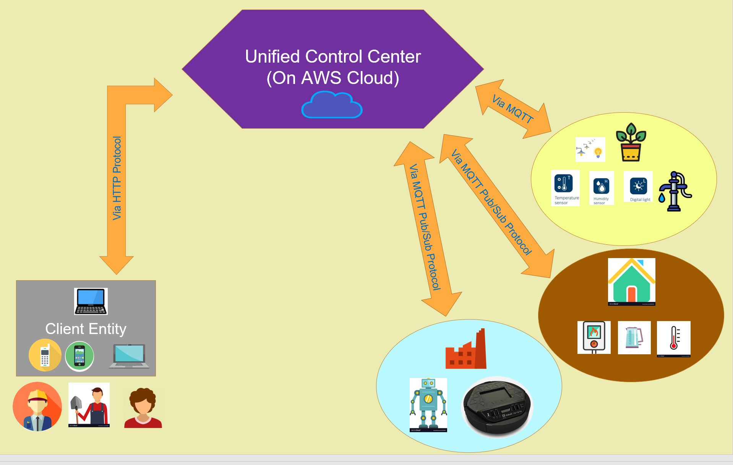
GRASP: Generalizable, Remote, Actuation & Sensing of a Process
Tanner DeKock, Lam Nguyen, Aditya Tyagi, David Vakshylak
Goal:
To create a system that allows a user to remotely view sensor outputs and control setpoints to actuate a processes. The system should be generalizable, so that it can control different processes in different application areas.
Integration:
Some sections have multiple figures in them. Explanation paragraph. Enough to explain what’s going on, but not so much text that it goes on and on. Much better to get to the point and let the pictures doc most of the talking.
Course Topics:
Sensing & Actuation
Feedback Control
Networking
Input & Output
Breadth Applications: Smart Home & Industry 4.0
Explanation paragraph. Enough to explain what’s going on, but not so much text that it goes on and on. Much better to get to the point and let the pictures do most of the talking.
Network Implementation:
The Unified Control Center acts as a liaison between the client entity and application level devices, facilitating data flow and control command flow.
Depth Application: Smart Garden
Explanation paragraph. Enough to explain what’s going on, but not so much text that it goes on and on. Much better to get to the point and let the pictures do most of the talking.
Evaluation:
Latency:
Sensor Accuracy:
Reliability:

Slide 2



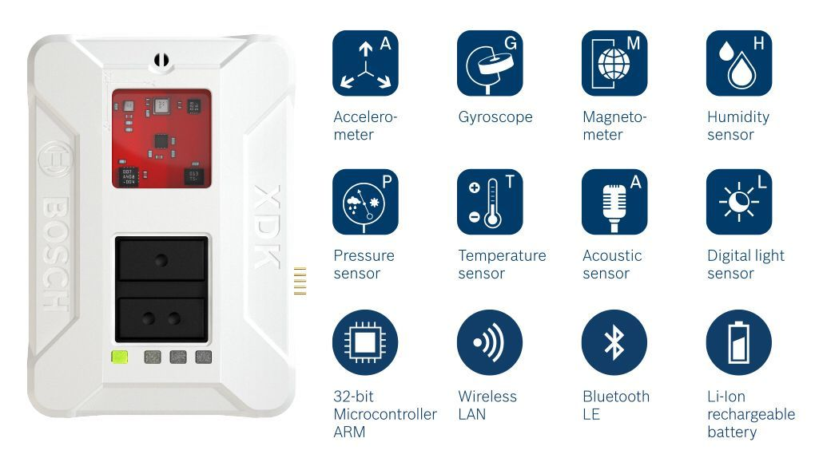




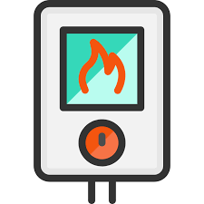

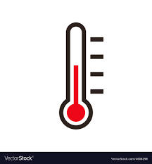






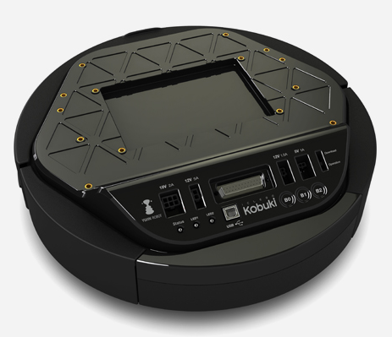

Unified Control Center (On AWS Cloud)
Via MQTT
Via HTTP Protocol
Via MQTT Pub/Sub Protocol
Via MQTT Pub/Sub Protocol
Client Entity

